Slide 1
Welcome to the
Infectious Diseases Module !
It has 5 units.
Each unit lasts about a week.
Each unit covers a critical question we need to answer if we want to understand infectious diseases.

Slide 2
  Welcome to the
  Infectious Disease module!
Unit 1: What is an infectious disease and why do we care?
Unit 2: What does it mean to have an infectious disease?
Unit 3: When does a microbe become pathogenic?
Unit 4: How do pathogens make us sick?
Unit 5: How do we get better?

Slide 3
Lesson Objectives:
After finishing today’s lesson, you will be able to:
explain what a disease is.
explain what makes a disease infectious.
explain why we care about infectious diseases.
name three impacts the flu has on society.

Slide 4
Do Now
  An infectious disease: a clinically evident illness resulting from the presence of infectious agents (pathogenic microbes, including viruses, bacteria, fungi, protozoa, and multicellular parasites)
  Disease – the impairment of overall health
  What infectious diseases do you know?
Notes:
An infectious disease: a clinically evident illness resulting from the presence of infectious agents (pathogenic microbes, including viruses, bacteria, fungi, protozoa, and multicellular parasites)
Disease – the impairment of overall health

Slide 5
Examples of infectious diseases:
Bacteria and fungi (single cell microbes) | Viruses (nonliving infectious agents) | Parasites (protozoa and worms)
Pneumonia MRSA Whooping cough Cholera Tuberculosis (TB) Typhoid fever Gastroenteritis Anthrax Chlamydia, etc. Yeast infection Athlete’s foot, etc. | Influenza A, the flu AIDS Smallpox Measles Chickenpox Herpes Common cold Warts Rabies Ebola Stomach flu, etc. | Sleeping sickness Malaria Toxoplasmosis, etc. Pinworm, etc.
Notes:
Note: in theory all infectious agents are ‘parasites’ since they use resources of the host. But for practical simplicity, the term’ parasite’ is reserved for protozoa and worms
Bacteria - Single-celled prokaryotic organisms (no nucleus).
Microbes – organisms invisible to the naked eye
Fungi - unicellular eukaryotic organisms with chitinous cell wall.
Viruses – Noncellular particle composed of genetic material protected by a protein shell and in some cases an envelope.
Protozoa - eukaryotic microbe that is not a fungus

Slide 6
Bacteria - Single-celled prokaryotic organisms (no nucleus).
Microbes – organisms invisible to the naked eye
Fungi - unicellular eukaryotic organisms with chitinous cell wall.
Viruses – Noncellular particle composed of genetic material protected by a protein shell and in some cases an envelope.
Protozoa - eukaryotic microbe that is not a fungus

Slide 7
Discussion
  What is the difference between a disease and an infectious disease?
  Transmission of microbes that replicate!!!
Notes:
An infectious disease: a clinically evident illness resulting from the presence of infectious agents (pathogenic microbes, including viruses, bacteria, fungi, protozoa, and multicellular parasites)
Disease – the impairment of overall health

Slide 8
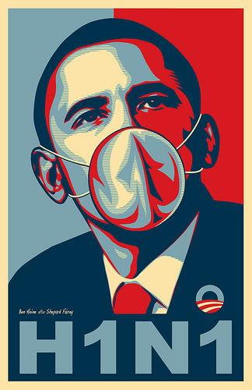
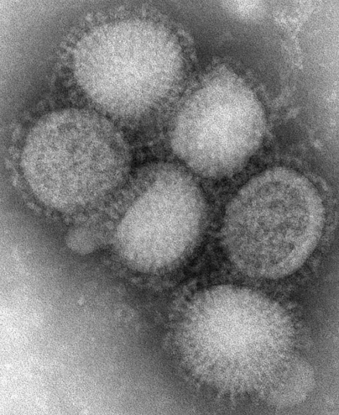
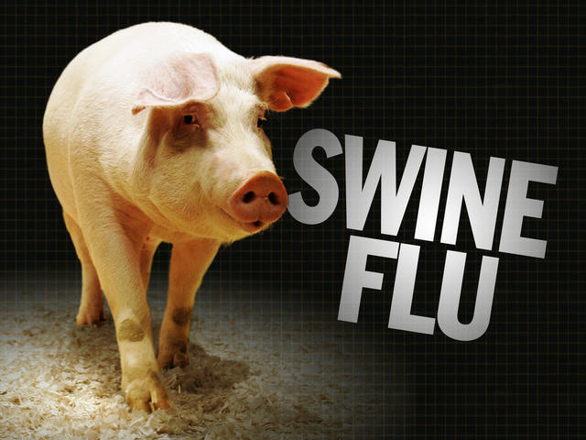
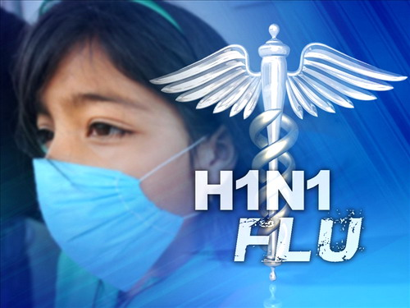
  Write down two pros and two cons of getting the flu shot.

Slide 9
Video: The 1918 Spanish Flu
Documentary
We heard the bells
NovaScience Video
Notes:
Remind the students to take notes about the impact the flu had on society.
Pandemic –a disease that is spread across continents or worldwide.

Slide 10
Wrap Up
  What impacts did the 1918 flu have on society?
  Thinking of the pros and cons you listed about the flu shot: what might have happened in 1918 if there was a flu shot available?
f
Notes:
Ask the students: what impact the flu had on society?
Ask students: what information we would need to have in order to make a prediction about whether H1N1 would evolve into a pandemic.

Slide 11
Homework
  Write a paragraph about three globally important infectious diseases:
      One bacterial or fungal
      One viral
      One parasitic or worms
  *Identify your sources*

